Slide 1

Introduction to JavaScript
Basic Syntax, Conditions and Loops
SoftUni Team
Technical Trainers
Software University
http://softuni.bg

Slide 2
Table of Contents
Introduction and IDE
Conditional Statements
Loops
While-Loop
For-Loop
Debugging and Troubleshooting

Slide 3
Have a Question?
sli.do
#tech-js

Slide 4

Introduction and IDE
Development Environments for JS

Slide 5
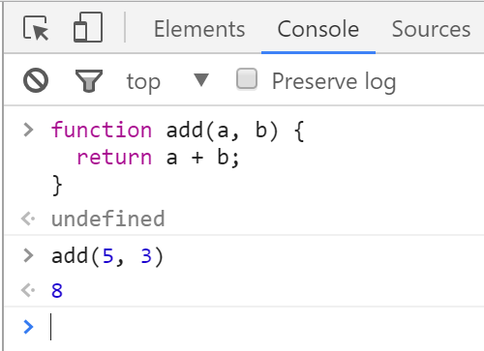

Chrome Web Browser
Developer Console: [F12]

Slide 6
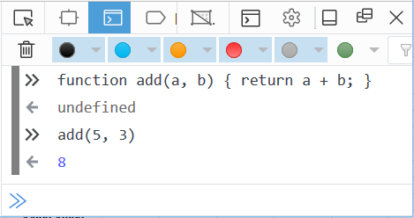

Firefox Web Browser
Developer Console: [Ctrl] + [Shift] + [i]

Slide 7
JavaScript Syntax
The JavaScript syntax is similar to C#, Java and PHP
Operators, Variables, Conditional statements, loops,
functions, arrays, objects and classes
Declare a variable with let
let a = 5;
let b = 10;
if (b > a) {
console.log(b);
}
Body of the conditional statement
Conditional statement

Slide 8
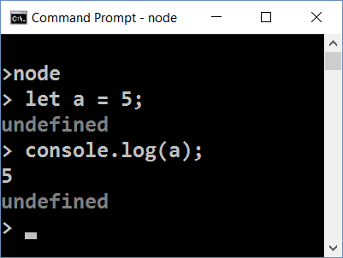
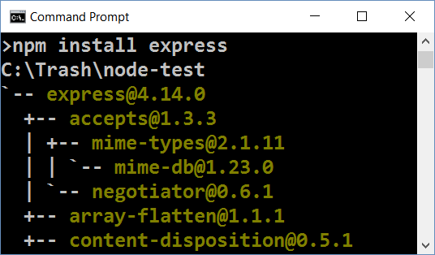
Node.js
What is Node.js?
Server-side JavaScript runtime
Chrome V8 JavaScript engine
npm package manager
Install node packages

Slide 9
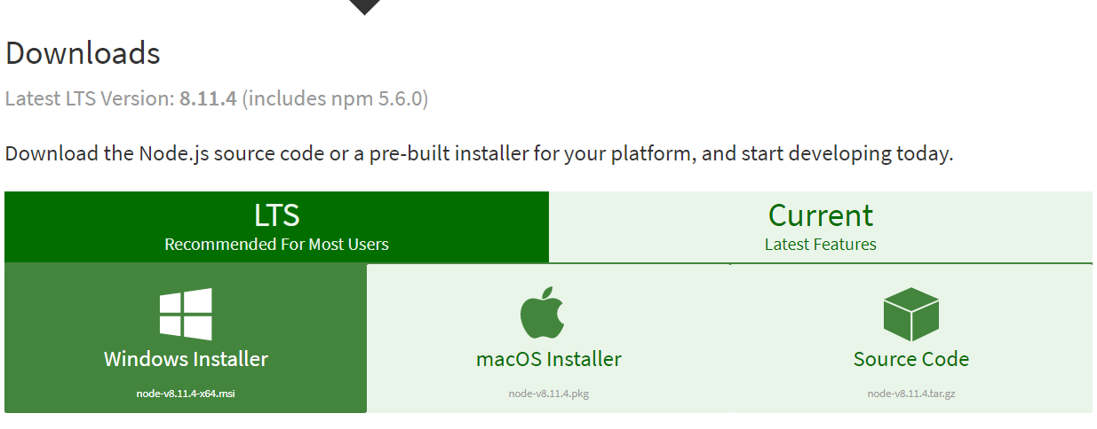
Install the Latest Node.js

Slide 10
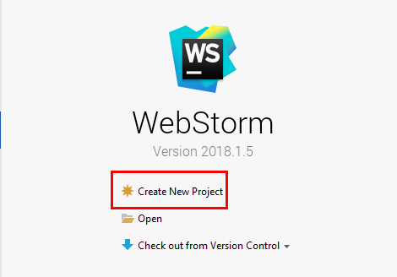
Using WebStorm
WebStorm is powerful IDE for JavaScript and other languages
Create a new project

Slide 11
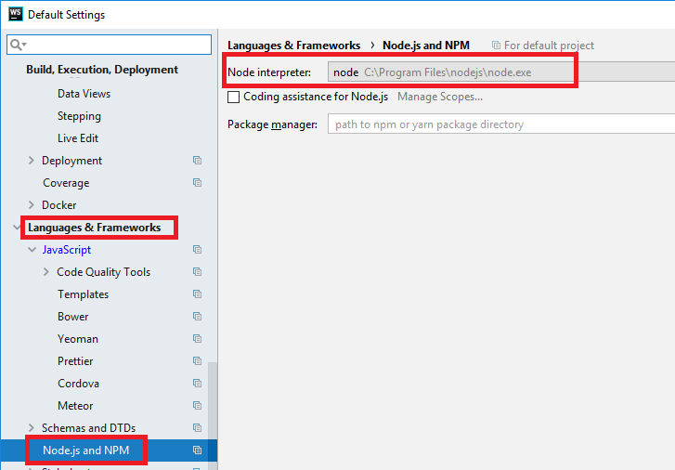
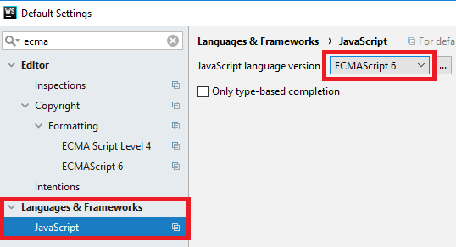
Configurations
Set up ECMAScript 6 and Node.js
ECMAScript6 is a standard for JavaScript
Node is environment for JavaScript

Slide 12
Functions
In order to solve different problems, we are going to use functions and the input will come as parameters
A function is block of code, that executes when called
declaration
parameters
function solve (num1, num2) { //some logic } solve(2, 3);
calling the function

Slide 13
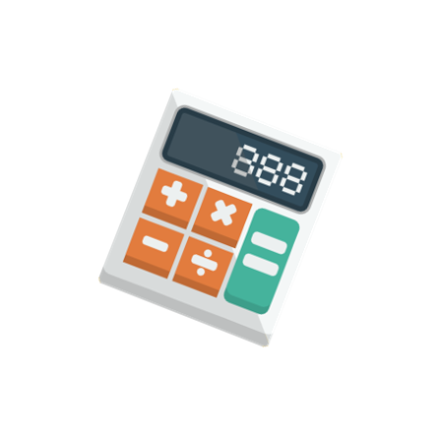
Problem: Multiply Number by Two
Write a function that receives a number and prints as result that number multiplied by two
Input
Output
2
4
function solve (num) {
console.log(num * 2);
}
solve(2);
Check your solution here: https://judge.softuni.bg/Contests/1189

Slide 14
Comparison Operators
Operator | Notation in JS
Equal value Equal value and type | == ===
Not equal value Not equal value/type | != !==
Greater than | >
Greater than or Equal | >=
Less than | <
Less than or Equal | <=

Slide 15
If (a > b)
Conditional Statements
Implementing Control-Flow Logic

Slide 16
What is Conditional Statement
The if-else statement:
Do action depending on condition
You can chain conditions
let a = 5;
if (a >= 5) {
console.log(a);
}
If the condition is met, the code will execute
else {
console.log('no');
}
Continue on the next condition, if the first is not met

Slide 17
Problem: Excellent Grade
Write a function that receives a single number and checks if the grade is excellent or not. If it is, print "Excellent", otherwise print "Not excellent"
function solve(grade){
if (grade >= 5.50) {
//TODO
} else {
//TODO
}
}
Input
Output
5.50
Excellent
4.35
Not excellent
Check your solution here: https://judge.softuni.bg/Contests/1189

Slide 18
for
while
Loops
Code Block Repetition

Slide 19
What are Loops
The for loop:
Repeats until a the condition is broken:
The while loop:
Does the same, but has different structure
for (let i = 1; i <= 5; i++){
console.log(i)
}
Incrementation in the condition
let i = 1
while (i <= 5) {
console.log(i)
i++ }
Incrementation outside the condition

Slide 20
Problem: Numbers from 1 to 5
Create a function that prints all the numbers from 1 to 5 (inclusive) each on a separate line
Output
function solve () {
for (let i = 1; i <= 5; i++) {
//TODO: print
}
}
1
2
3
4
5
Check your solution here: https://judge.softuni.bg/Contests/1189

Slide 21
Problem: Numbers from N to 1
Write a function that receives a number and prints the numbers form N to 1. Try using while loop
Input
Output
function solve(n) { while(/*TODO*/) { console.log(n); n--; } } solve(5);
5
5
4
3
2
1
Check your solution here: https://judge.softuni.bg/Contests/1189

Slide 22

Debugging the Code
Using the WebStorm Debugger

Slide 23

Debugging the Code
The process of debugging application includes:
Spotting an error
Finding the lines of code that cause the error
Fixing the error in the code
Testing to check if the error is gone and no new errors are introduced
Iterative and continuous process

Slide 24
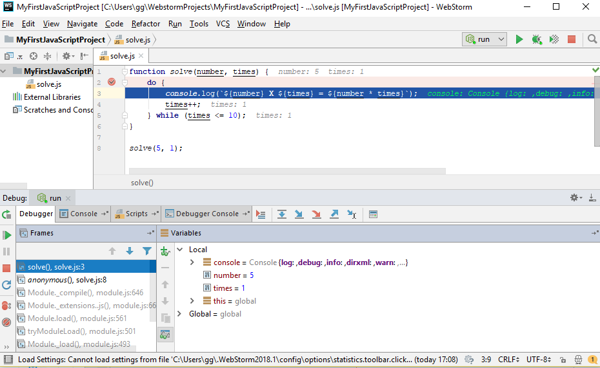
Debugging in WebStorm
WebStorm has a built-in debugger
It provides:
Breakpoints
Ability to trace the code execution
Ability to inspect variables at runtime

Slide 25
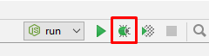
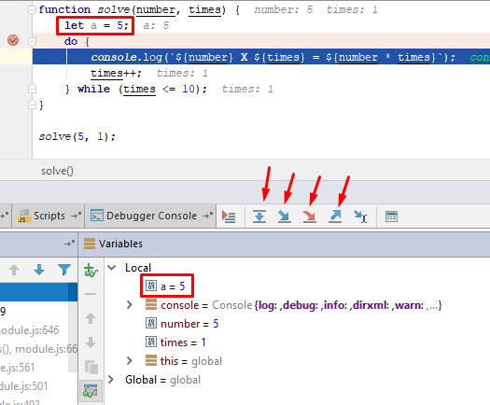
Using the Debugger in WebStorm
Start without Debugger: [Shift+F10]
Toggle a breakpoint: [Shift+F9]
Trace step by step: [F7]
Force step into: [Alt+Shift+f7]
Using the Local
Conditional breakpoints
Enter debug mode after exception

Slide 26

Live Exercises

Slide 27

Summary
…
…
…
We declare variables with 'let'
We use if-else statements to check for conditions
We use loops to avoid repeating code
We use the debugger to check for mistakes in the code

Slide 28
https://softuni.bg/courses/technology-fundamentals

Slide 29












SoftUni Diamond Partners

Slide 30




SoftUni Organizational Partners

Slide 31




Trainings @ Software University (SoftUni)
Software University – High-Quality Education and Employment Opportunities
softuni.bg
Software University Foundation
http://softuni.foundation/
Software University @ Facebook
facebook.com/SoftwareUniversity
Software University Forums
forum.softuni.bg

Slide 32

License
This course (slides, examples, demos, videos, homework, etc.) is licensed under the "Creative Commons Attribution-NonCommercial-ShareAlike 4.0 International" license

